Slide 1
Announcements
Weds. Feb. 10th Early Release
Monday, Feb. 15- BISD Holiday, but not for ACC
9th and 10th Grade PSAT Weds. Feb. 24th from 8:40-12 PM

Slide 2
Keep yourself healthy and Happy
Today’s goal is Wash Your Hands the Right Way
Previous goals:
Eat your Breakfast
Drink More Water
Exercise

Slide 3
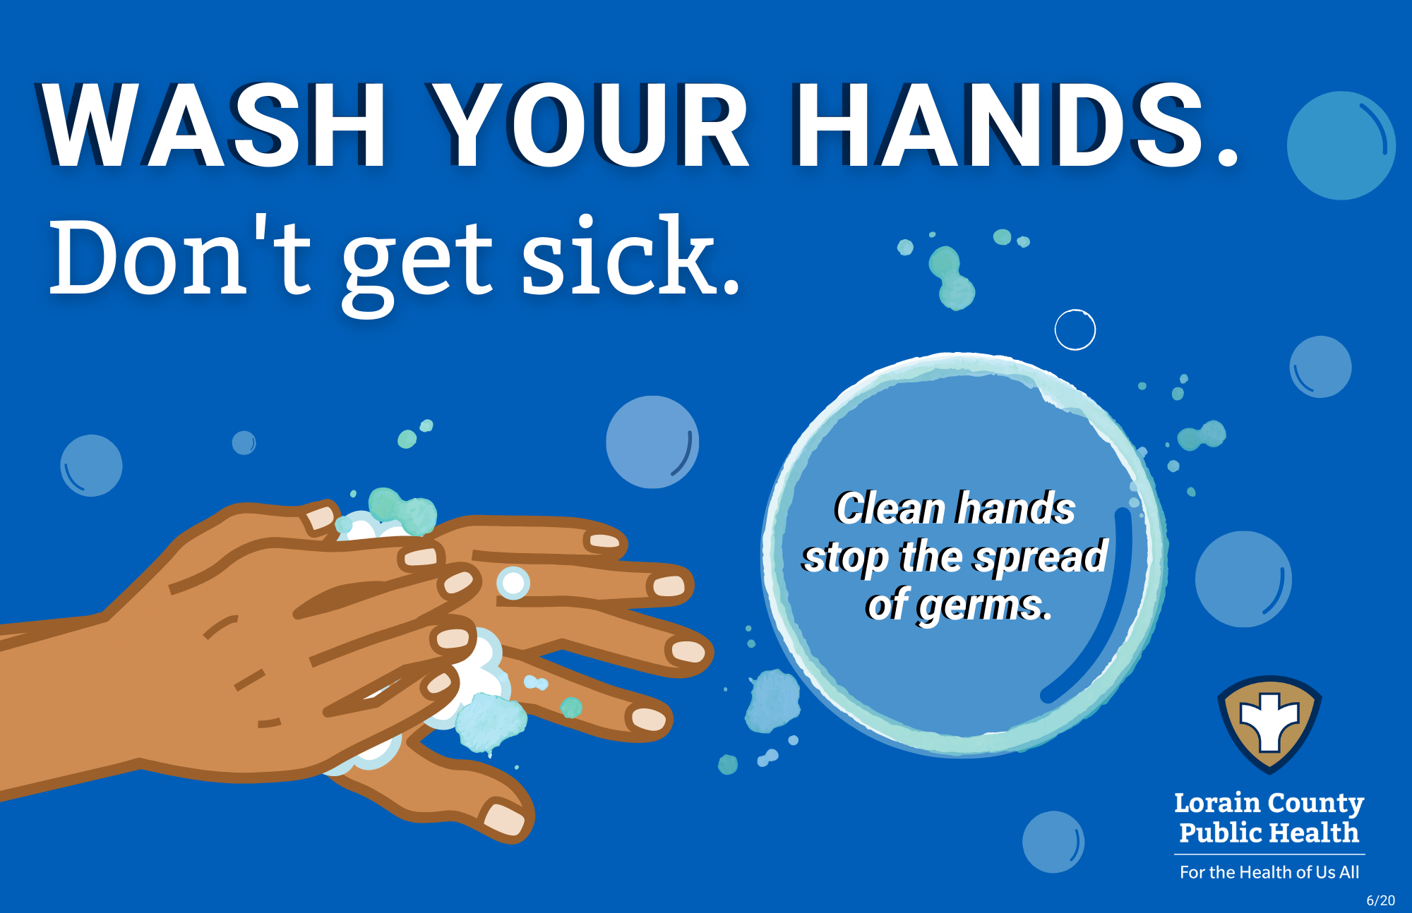
Wash Your hands
Hopefully, you wash your hands on a regular basis, especially after using the restroom and before eating a meal.
Washing your hands can keep you healthy and prevent respiratory (breathing) infections.
Germs can spread between people and on surfaces.

Slide 4
Wash Your hands the correct way
Follow these five steps from the CDC every time:
Wet your hands with clean, running water (warm or cold), turn off the tap, and apply soap.
Lather your hands by rubbing them together with the soap. Lather the backs of your hands, between your fingers, and under your nails.
Scrub your hands for at least 20 seconds. Need a timer? Hum the “Happy Birthday” song from beginning to end twice.
Rinse your hands well under clean, running water.
Dry your hands using a clean towel or air dry them.

